Slide 1

Production-like Kubernetes on your laptop!

Slide 2

Kubernetes

Slide 3



So we want to know about Kubernetes but how do we get started?

Slide 4
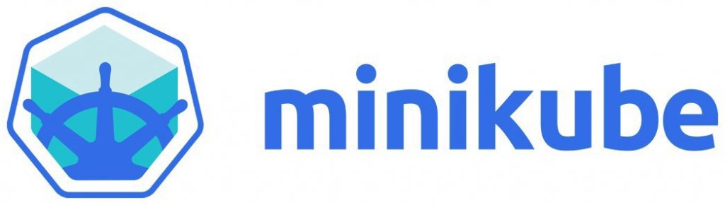


Kubernetes environments
For developers Quick to setup, light on resources but lacking
For production Require time and other resources to setup
Do-it-yourself
Kubernetes (https://github.com/kubernetes/kubernetes)
Kubespray (https://github.com/kubernetes-sigs/kubespray)
OKD
PaaS solutions at cloud providers
Google Cloud Platform (GCP)
Amazon Elastic Kubernetes Service (EKS)
Red Hat OpenShift
Azure Kubernetes Service (AKS)

Slide 5

Kubernetes for developers
Using Minikube, Microk8s, K3s
Single node
Not isolated from the host
No loadbalancer
No distributed storage
No production-like network
No external container registry
No exposed host (for webhooks)

Slide 6

Kubernetes for developers
Using Minikube, Microk8s, K3s
Single node
Not isolated from the host
No loadbalancer
No distributed storage
No production-like network
No external container registry
No exposed host (for webhooks)

Slide 7
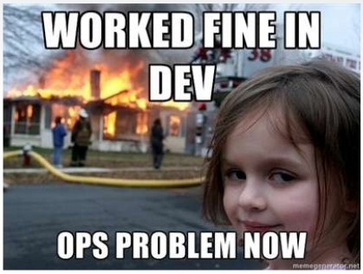
Kubernetes for developers
Minikube / Microk8s / K3s are not production-like environments!
Several tools won’t work such Jenkins X
More complex container solutions are difficult to deploy or test locally

Slide 8
Kubernetes environment What does it consist of?
Kubernetes
Management tools
PaaS
Operating System
IaaS
Hardware
Notes:
Hosts, certificate management

Slide 9

Kubernetes for developers
Minikube on Hyper-V / Virtualbox using Vagrant Poor performance VirtualBox and Hyper-V are no friends Minikube is lacking
Kubernetes using Vagrant on KVM Who will maintain my scripts?
Kubernetes using Juju on LXC/LXD LXC/LXD is light-weight but containerinception! Comparable to Docker, no true isolation
Kubernetes using Juju + MAAS on KVM

Slide 10
Juju? MAAS? What is he talking about?

Slide 11

Juju
Charms Scripts to make deployment and operations easy For example Nagios, Elasticsearch, Memcached, Private Docker Registry, Vault
Bundles A collection of Charms and Relations which provide a platform For example Kubernetes, Hadoop Spark cluster, OpenStack

Slide 12

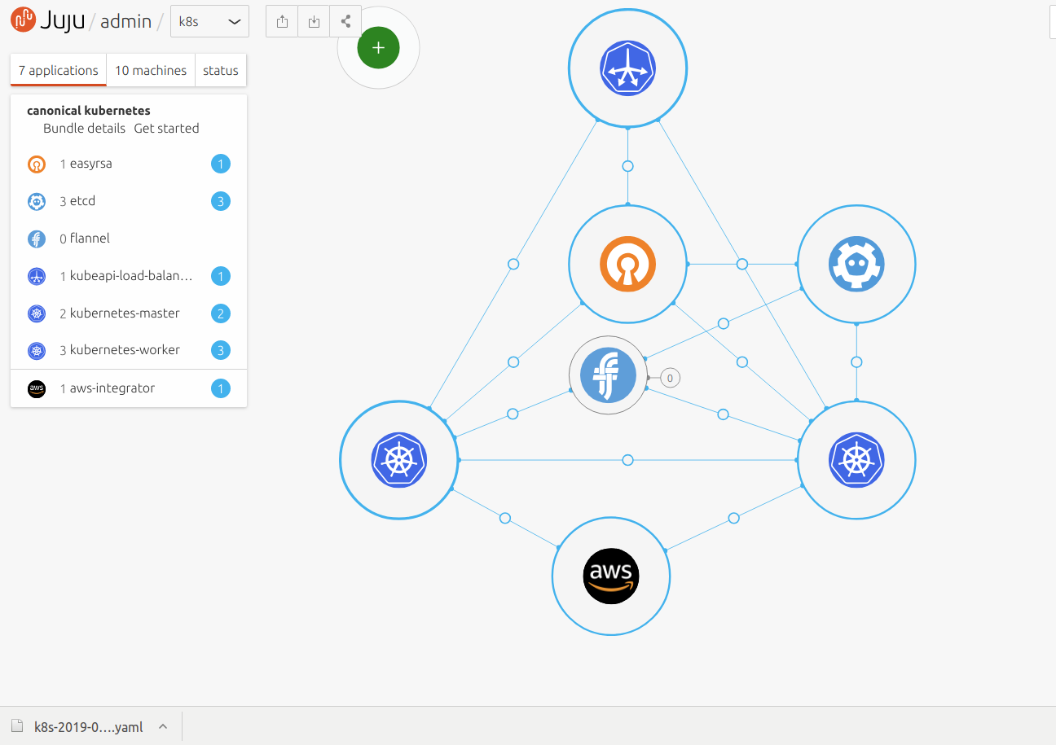
Juju benefits
Quick and easy
Deployments
Configuration
Integration
Quick and easy operations
Public cloud
Private cloud
Bare metal / KVM (MAAS)
Local environment (LXC/LXD)

Slide 13
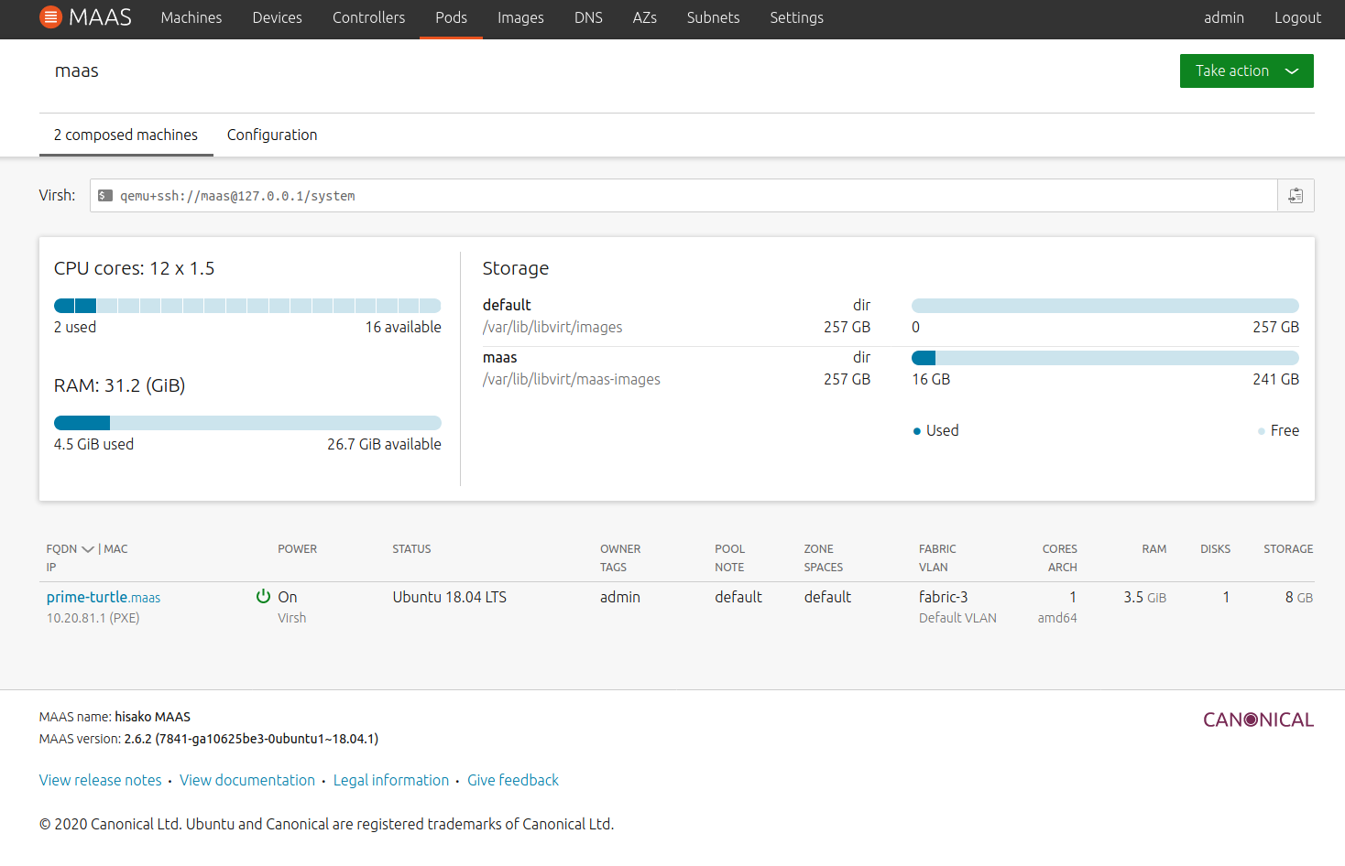
MAAS – Metal as a Service Your local IaaS solution!
Cloud style provisioning for physical servers (or KVM!)
Create and remove KVM machines You can overprovision!
Provisioning using network boot (PXE)
Configuration of DHCP, subnets, network boot images

Slide 14
DEMO

Slide 15
How to set-up Juju and MAAS

Slide 16





Prerequisites
MAAS / Juju
Ubuntu (deb packages)
Snap on Debian, RHEL, other
KVM
Libvirt
OpenSSH
Network configuration
Host bridge interface
Host firewall
Libvirt

Slide 17
MAAS
Requests machines
MAAS
libvirtd

Slide 18
MAAS
MAAS
libvirtd
Creates machines
KVM machine
KVM machine
KVM machine
KVM machine

Slide 19
MAAS
Provisions machines
MAAS
libvirtd
DHCP
PXE
KVM machine
Netwerk
bridge
KVM machine
KVM machine
KVM machine

Slide 20
MAAS

Slide 21
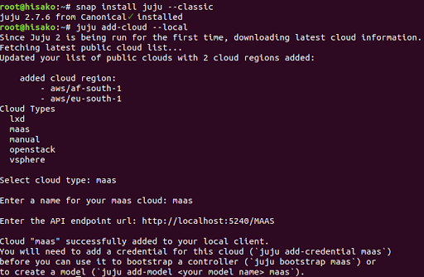
Install Juju

Slide 22
Juju: bootstrap the controller
Juju
Request machine
MAAS

Slide 23
Juju: bootstrap the controller
Juju
KVM machine
Juju Controller
Provision machine
MAAS

Slide 24
Juju: bootstrap the controller
Install controller software
Juju
KVM machine
Juju Controller
MAAS

Slide 25
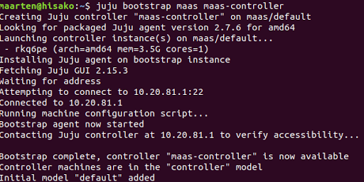
Juju: bootstrap the controller

Slide 26
Juju: install Kubernetes
Juju
Requests machines
MAAS

Slide 27
Juju: install Kubernetes
Juju
KVM machine
Juju Controller
KVM machine
KVM machine
MAAS
KVM machine
KVM machine
Provisions machines

Slide 28
Juju: install Kubernetes
Requests deployment
Juju
KVM machine
Juju Controller
KVM machine
KVM machine
MAAS
KVM machine
KVM machine

Slide 29
Juju: install Kubernetes
Juju
KVM machine
Juju Controller
Deploys Kubernetes
KVM machine
KVM machine
MAAS
KVM machine
KVM machine

Slide 30
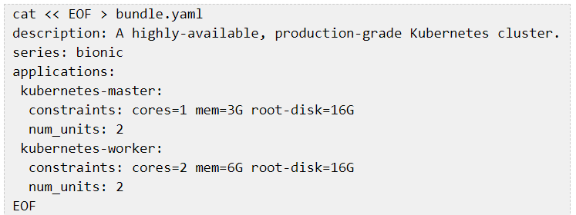
Juju: install Kubernetes
juju add-model k8s
juju deploy charmed-kubernetes --overlay bundle.yaml –trust (creates VMs, provisions VMs, installs Kubernetes)

Slide 31

Juju: install Kubernetes
juju add-model k8s
juju deploy charmed-kubernetes --overlay bundle.yaml –trust (creates VMs, provisions VMs, installs Kubernetes)
juju destroy-model k8s
removes VMs releases claimed resources

Slide 32
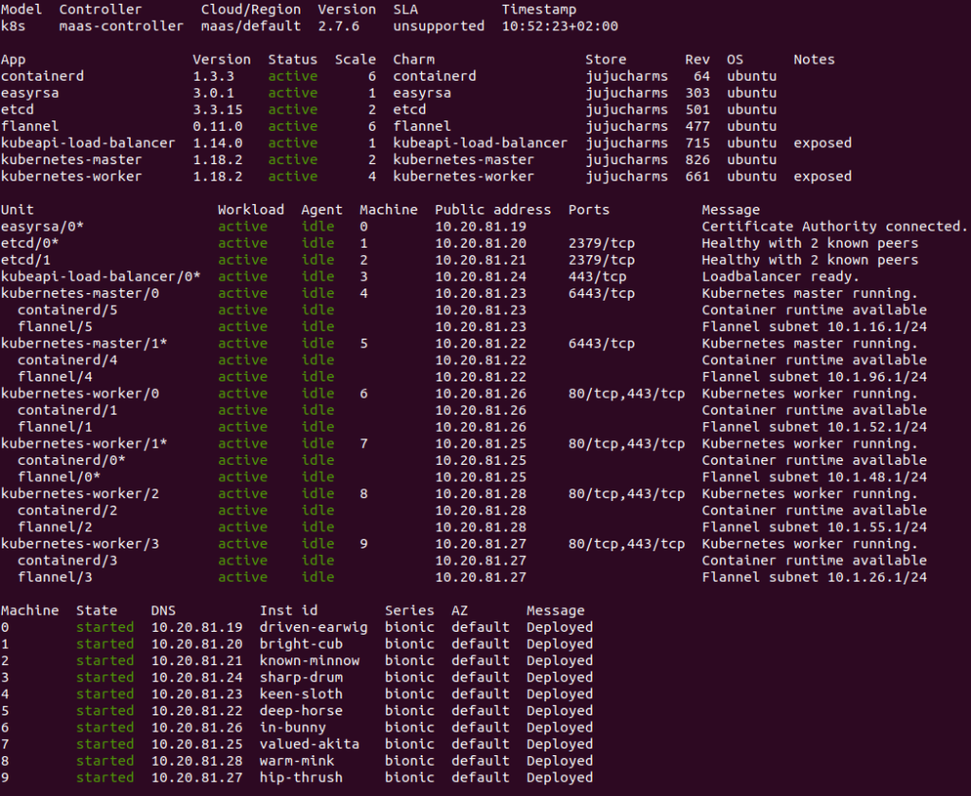

Slide 33


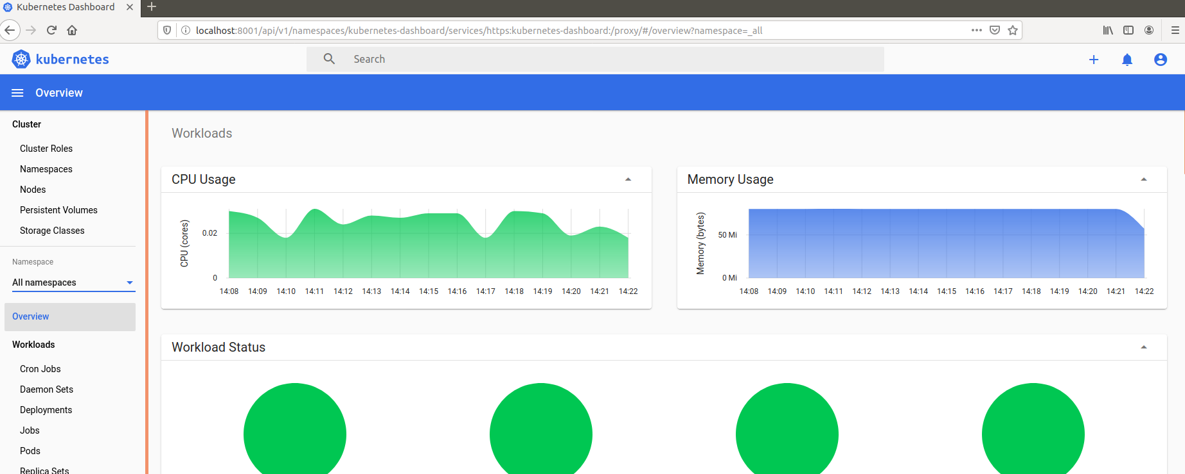
Result
Achieved Single command create and destroy No script maintenance Easily scale/expand/integrate
Still lacking Private container registry Loadbalancer Distributed storage solution

Slide 34
DEMO

Slide 35
Private container registry The power of Juju
juju deploy ~containers/docker-registry
juju add-relation docker-registry easyrsa:client
juju config docker-registry auth-basic-user='admin' auth-basic-password='admin'
juju add-relation docker-registry containerd
export IP=`juju run --unit docker-registry/0 'network-get website --ingress-address'`
export PORT=`juju config docker-registry registry-port`
export REGISTRY=$IP:$PORT
juju config containerd custom_registries='[{"url": "https://'$REGISTRY'", "username": "admin", "password": "admin"}]'

Slide 36

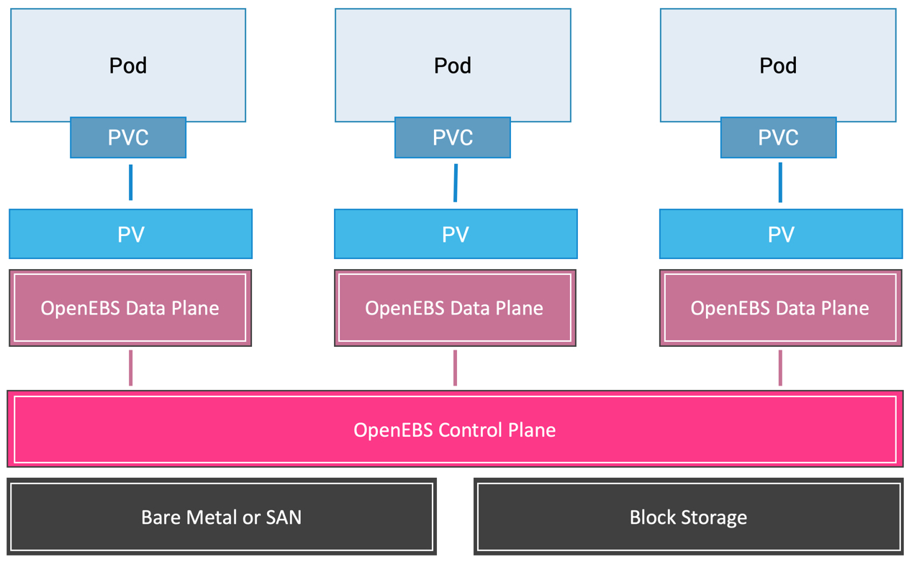
OpenEBS
100% Open Source
CNCF project
Kubernetes native
Multi cloud

Slide 37

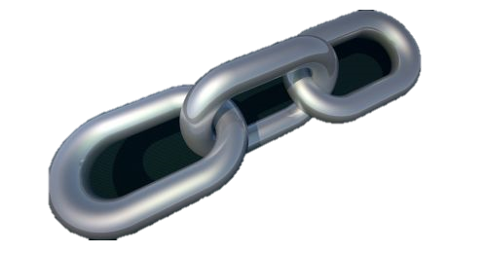



Why OpenEBS?
Kubernetes native Unlike CephFS, Gluster, Flocker
Cloud provider independent Unlike
EBS (AWS)
Cinder (OpenShift)
gcePersistentDisk (GCP)
vsphereVolume
No external dependencies! StorageOS requires an external etcd
Easy to install

Slide 38
Installing OpenEBS
juju run "systemctl enable iscsid && systemctl start iscsid" --application kubernetes-worker
juju config kubernetes-master allow-privileged=true
juju run "reboot" --application kubernetes-worker
juju run "reboot" --application kubernetes-master
kubectl create namespace openebs
helm repo add openebs https://openebs.github.io/charts
helm repo update
helm install openebs stable/openebs --version 1.10.0 --namespace openebs
kubectl patch storageclass openebs-jiva-default -p ‘{ "metadata": { "annotations": { "storageclass.kubernetes.io/is-default-class": "true“ } } }'
Prepare
Install
Configure

Slide 39

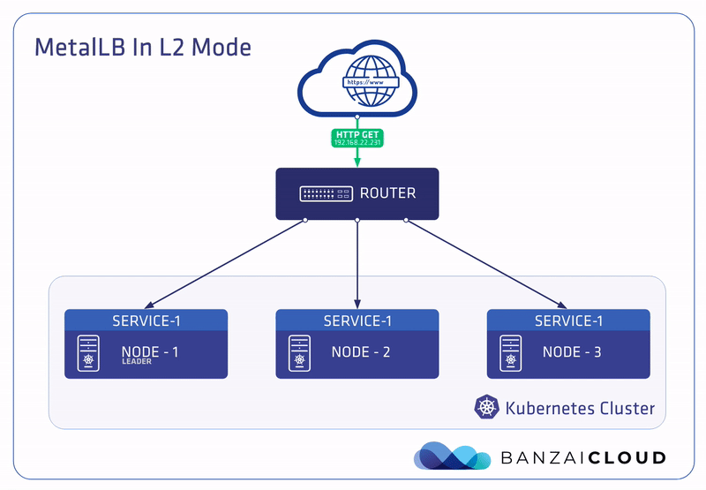
Kubernetes has no default implementation of Services of type LoadBalancer
LoadBalancers will remain in the “pending” state indefinitely when created
Alternatives to LB are limited “NodePort” and “externalIPs”
MetalLB provides a LB implementation which ‘just works’ on bare metal

Slide 40
Installing MetalLB
cat << EOF > metallb-config.yaml
configInline:
address-pools:
- name: default
protocol: layer2
addresses:
- 10.20.81.190-10.20.81.253
EOF
helm install metallb -f metallb-config.yaml stable/metallb

Slide 41
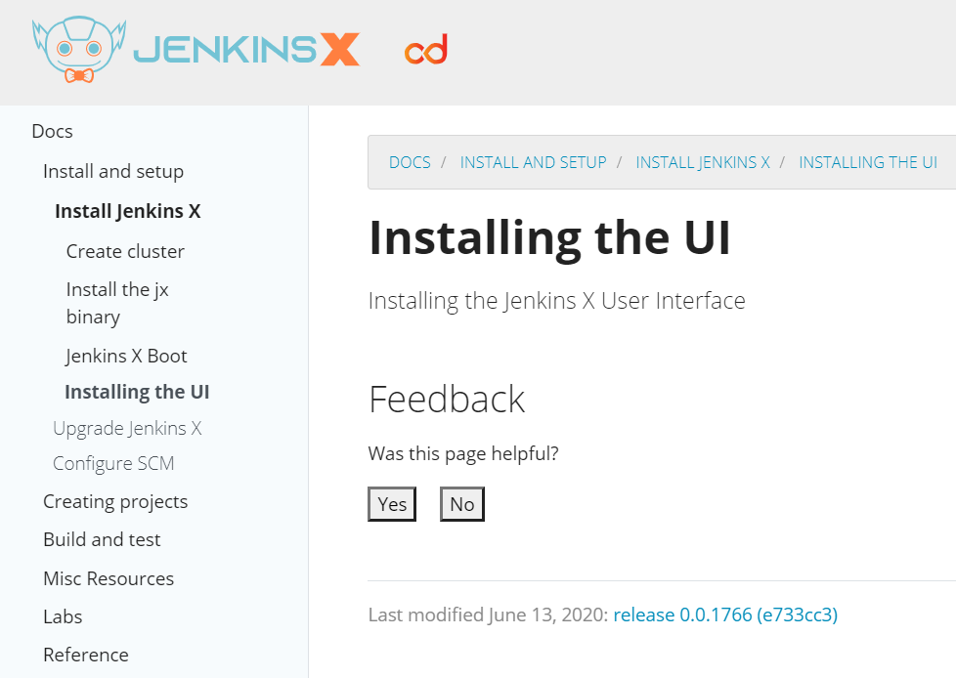
Jenkins X
Only supported on GCP and EKS (AWS) using GitHub
Many undocumented requirements / bugs
Loadbalancer
Private Docker registry on HTTPS
Publicly exposed cluster (smee.io)
No UI Does not use Jenkins anymore but Tekton (serverless pipelines) and Prow (webhooks)
Not easy to recover from failures Configuration is spread locally, inside Kubernetes and in GitHub

Slide 42
Jenkins
helm repo add stable https://kubernetes-charts.storage.googleapis.com/
helm repo update
kubectl create namespace jenkins
helm install my-jenkins-release stable/jenkins --namespace jenkins

Slide 43
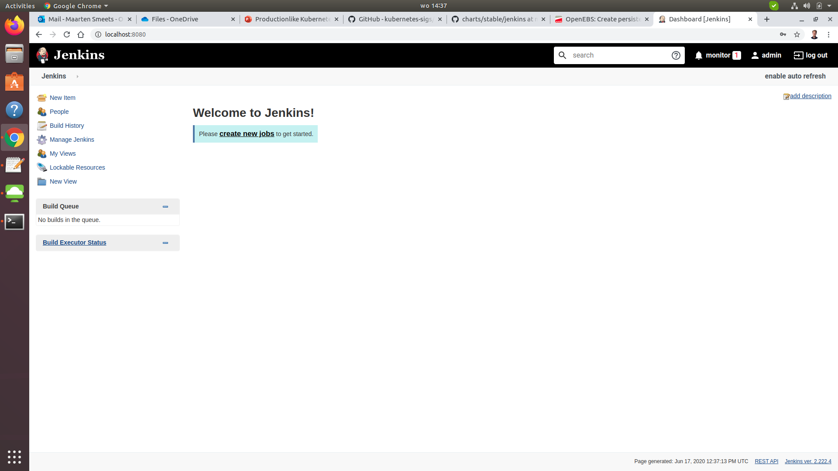
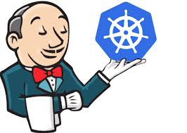
Jenkins

Slide 44
DEMO

Slide 45

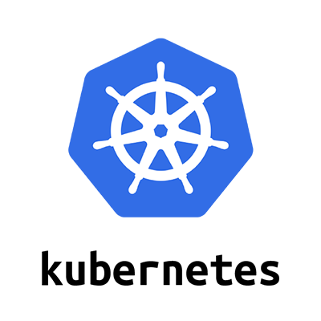



For more information
Charmed Kubernetes on KVM using MAAS and Juju https://technology.amis.nl/2020/05/20/charmed-kubernetes-on-kvm-using-maas-and-juju/
OpenEBS: Create persistent storage in your Charmed Kubernetes cluster quick and easy! https://technology.amis.nl/2020/05/22/openebs-create-persistent-storage-in-your-charmed-kubernetes-cluster-quick-and-easy/
Used scripts https://github.com/MaartenSmeets/kube-prov/tree/master/scripts

